Slide 1

New Features in the .NET 9 JIT
Andy Ayers

Slide 2
Agenda
Intro
Objects
Arm64
Just In Time (JIT) compilation How to look at jitted code
Stack allocation of boxes Stack allocation of ref classes Physical promotion of object fields
Scalable Vector Extensions (SVE)
Loops
General
Wrap-Up
Induction Variable (IV) analysis Linear Function Test Replacement Strength Reduction Post-increment (ARM64)
Profile Guided Optimization (PGO) for casts Shared generics inlining
What you need to do How to reach us Resources

Slide 3

The .NET JIT aka “codegen”
In this talk: a sample of the codegen improvements
found in .NET 9
Compilation in .NET is a two-step process:
Language compiler (Roslyn, csc) -> C# to IL
JIT compiler (RyuJit) -> IL to machine code
The JIT includes code generators for x64, x86, Arm, Arm64
(plus Risc-V, Loongarch, …) (plus ISA Variants AVX, AVX-512 … Arm 8.x, some 9.x) (plus ABI support for Windows/SysV/MacOS/…)
Method-at-a-time compilation, usually “Just In Time”
The JIT also handles codegen for “ahead of time” NAOT/R2R

Slide 4
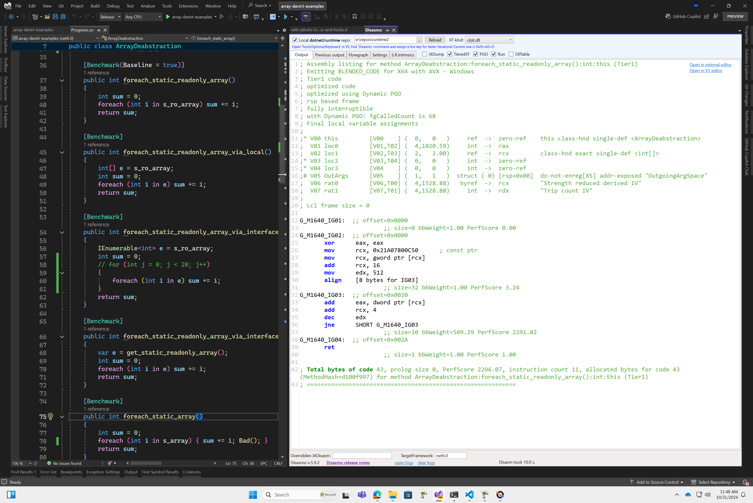
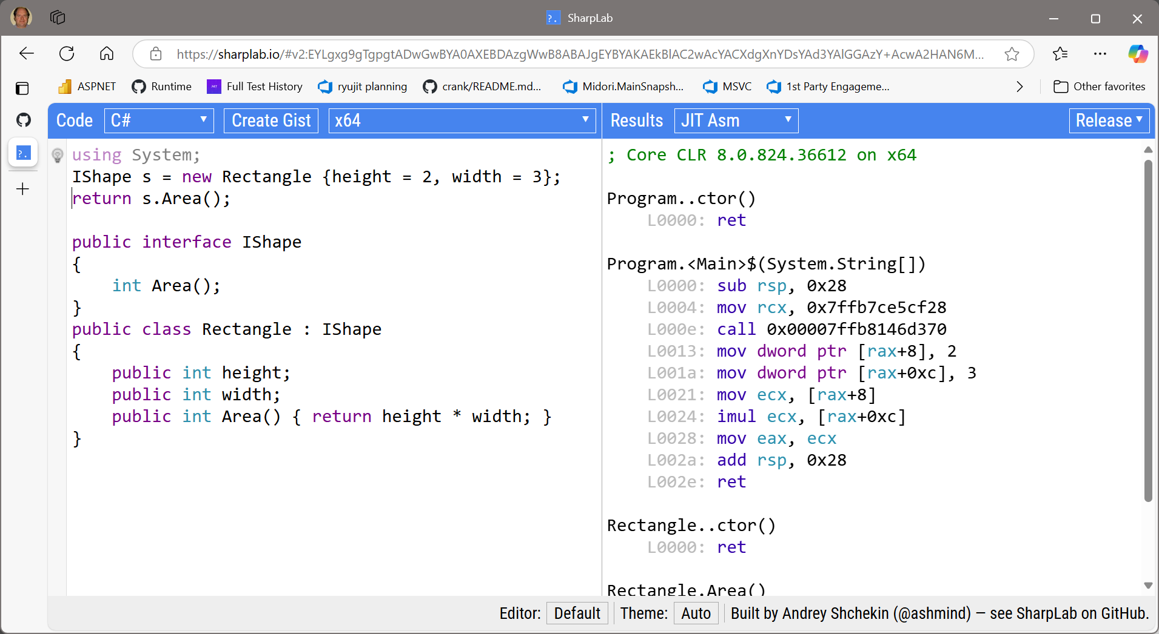
How to look at JIT-created code
Via Command Line
;; see all methods that got jitted
dotnet build –c release
set DOTNET_JitDisasmSummary=1 set DOTNET_JitStdOutFile=<file>
dotnet exec <release dll>
;; see codegen for specific method or method
set DOTNET_JitDisasm=<pattern> dotnet exec <release dll>
Via Tools: Disasmo (VS Add-in)
Via the Web: sharplab.io

Slide 5
Objects
Escape Analysis and the optimizations it enables

Slide 6
Ref vs Value Types
Ref Types (aka “objects”)
Value Types (aka “structs”)
Allocated on the GC heap
Lifetime determined by GC
Allocated on the stack
or (if boxed) on the GC heap
If on the stack:
Value type fields can be promoted by the JIT
Promoted fields can live in registers and be aggressively optimized
lifetime is tied to the lifetime of the stack frame
If on the heap:
Lifetime determined by GC
Often must be “unboxed” (copied to a stack allocated instance) to be used in computation

Slide 7
Object stack allocation
Less heap allocation, better code optimization
If the JIT can prove the object lifetime is constrained by the stack frame lifetime, the JIT can treat a ref type like a value type
Objects can be allocated on the stack
and possibly have their fields promoted
and be aggressively optimized
This also works for boxed value types.
Key enabler is the lifetime proof, via escape analysis
[Java/Go have done this since forever]

Slide 8
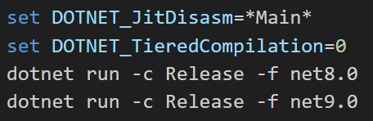
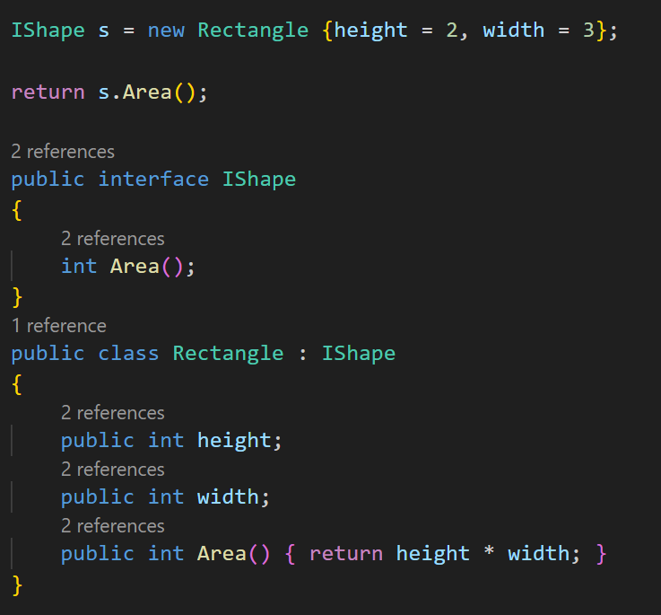
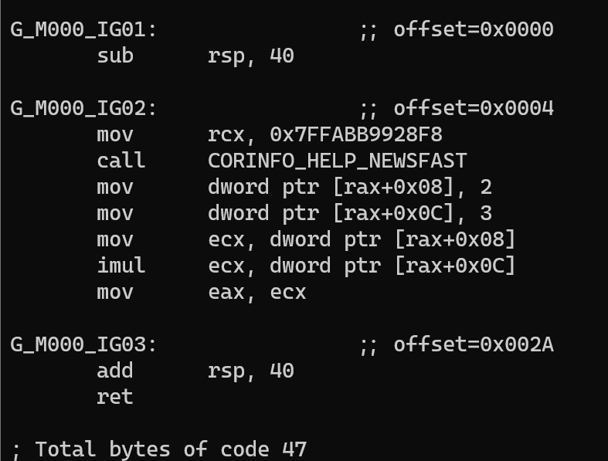
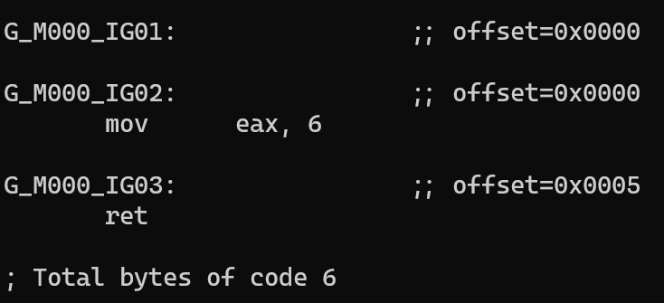
Example
8.0 Codegen
9.0 Codegen
No object, no fields, no computation

Slide 9
ARM64
Scalable Vector Extension (SVE) [Experimental in .NET 9]

Slide 10
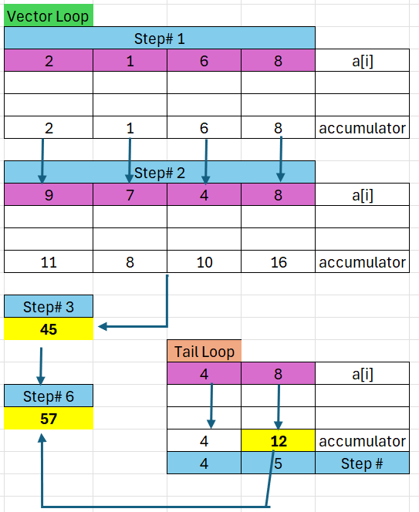
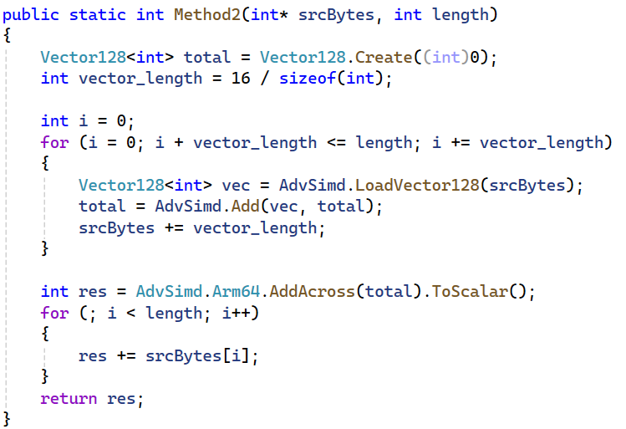
SVE: Tail loop

Slide 11
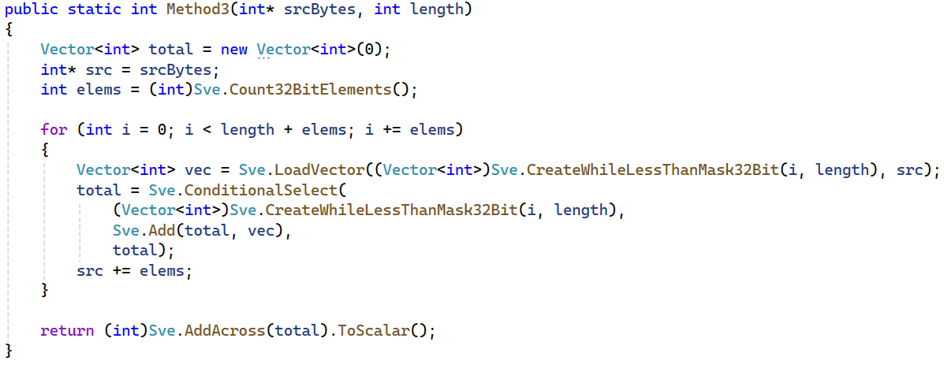
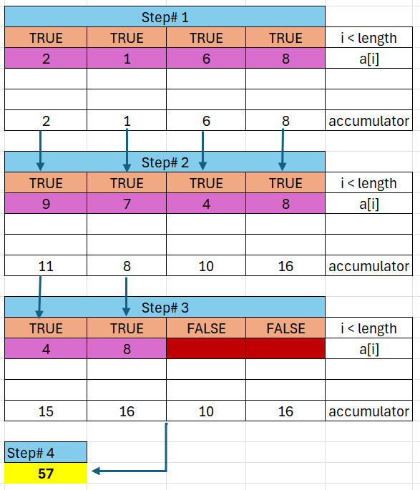
No tail loop needed with SVE
Leverages predicated (masked) operations

Slide 12

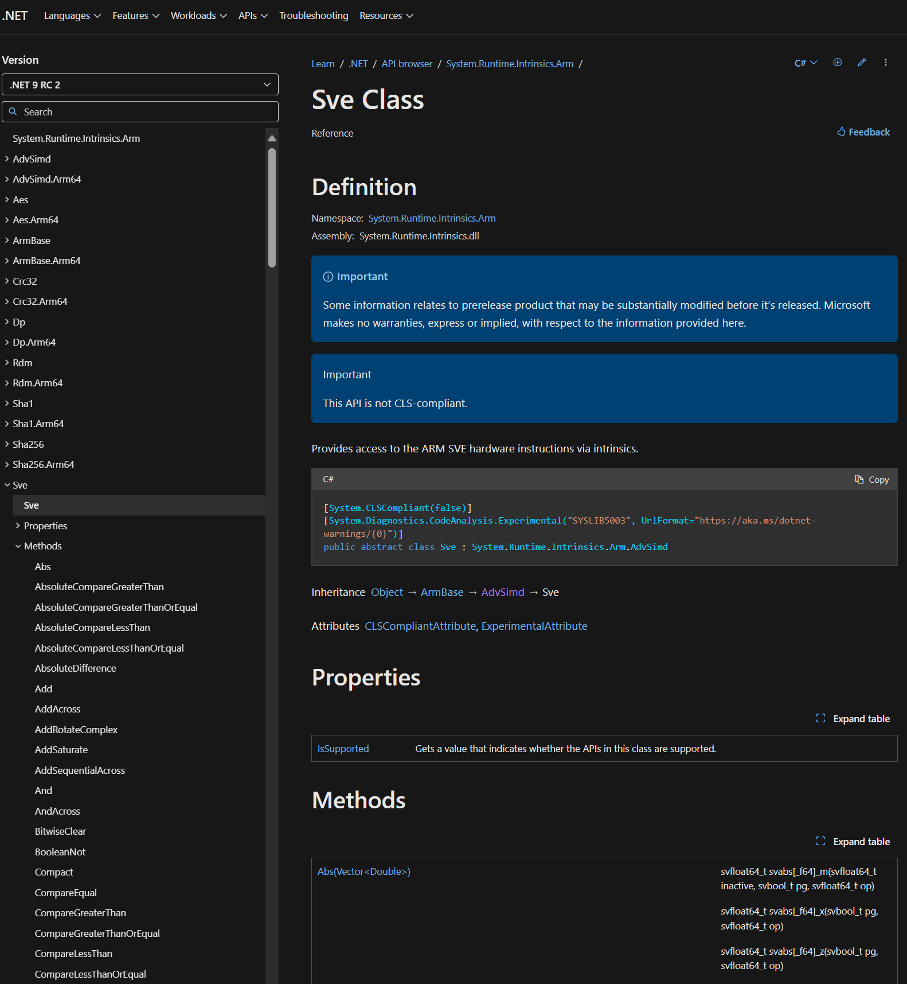
SVE in .NET 9
281 APIs for SVE v1 intrinsics
Bitwise, Math, Counting, Load/Store, Scatter/Gather, FP, FirstFaulting
1123 instructions for SVE v1 and v2
Vector<T> scalable vectors and predicates
16 bytes vector length

Slide 13
Loops
Induction Variables++

Slide 14
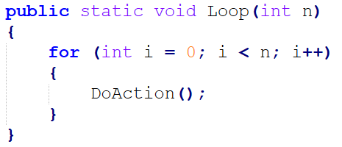
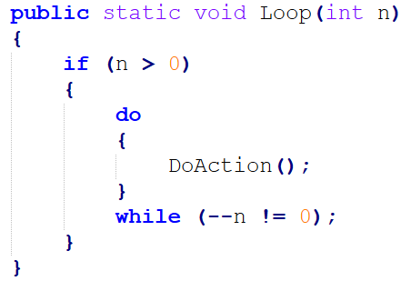
Linear Function Test Replacement
The loop is converted to the equivalent loop on the right
Codegen for loop is smaller and uses fewer registers
G_M000_IG02:
xor esi, esi
test ebx, ebx
jle SHORT G_M000_IG04
G_M000_IG03:
call [Program:DoAction()]
inc esi
cmp esi, ebx
jl SHORT G_M000_IG03
G_M28474_IG02:
test ecx, ecx
jle SHORT G_M28474_IG05
G_M28474_IG03:
mov ebx, ecx
G_M28474_IG04:
call [Program:DoAction()]
dec ebx
jne SHORT G_M28474_IG04

Slide 15
Strength Reduction
public static double IV(int n)
{
double sum = 0;
if (n > 0)
{
int i = 0;
do
{
sum += i;
i += 3;
}
while (--n != 0);
}
return sum;
}
public static double IV(int n)
{
double sum = 0;
for (int i = 0; i < n; i++)
{
sum += i * 3;
}
return sum;
}
The loop is rewritten as the equivalent loop on the right, which no longer multiplies on every iteration.
Linear function test replacement rephrased the loop test to avoid the dependency on “i“.

Slide 16
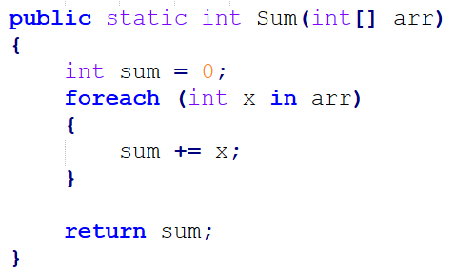
Post-Increment Addressing
For arm64, strength reduction enables post-increment addressing modes for array accesses inside loops
G_M53154_IG02:
mov w1, wzr
mov w2, wzr
ldr w3, [x0, #0x08]
cmp w3, #0
ble G_M53154_IG05
G_M53154_IG03:
add x0, x0, #16
G_M53154_IG04:
ldr w4, [x0, w2, UXTW #2]
add w1, w4, w1
add w2, w2, #1
cmp w3, w2
bgt G_M53154_IG04
G_M53154_IG02:
mov w1, wzr
ldr w2, [x0, #0x08]
cmp w2, #0
ble G_M53154_IG05
G_M53154_IG03:
add x0, x0, #16
G_M53154_IG04:
ldr w3, [x0], #0x04
add w1, w3, w1
sub w2, w2, #1
cbnz w2, G_M53154_IG04
.NET 9
.NET 8

Slide 17
General Optimizations
PGO & Inlining

Slide 18
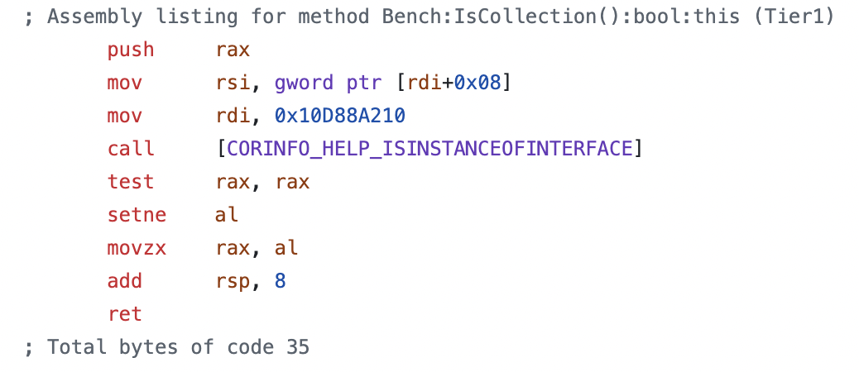
Profiled Casts
.NET 8.0 Codegen
object _obj = new MyClass[2];
[Benchmark]
public bool IsCollection() =>
_obj is ICollection<MyClass>;

Slide 19
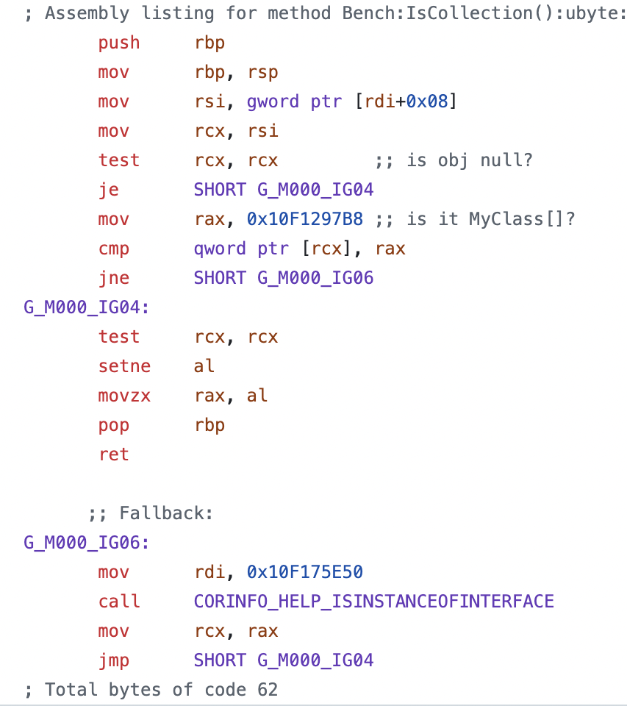
Profiled Casts
.NET 9.0 Codegen
object _obj = new MyClass[2];
[Benchmark]
public bool IsCollection() =>
_obj is ICollection<MyClass>;

Slide 20
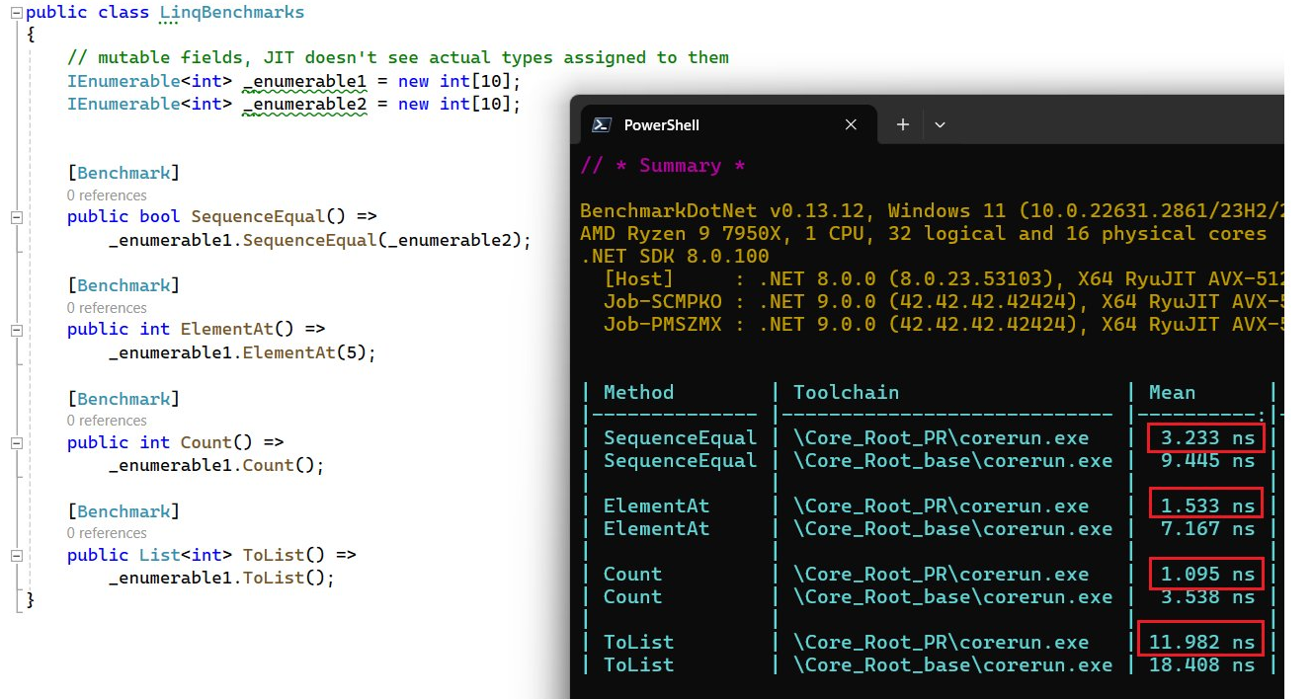
Profiled Casts

Slide 21
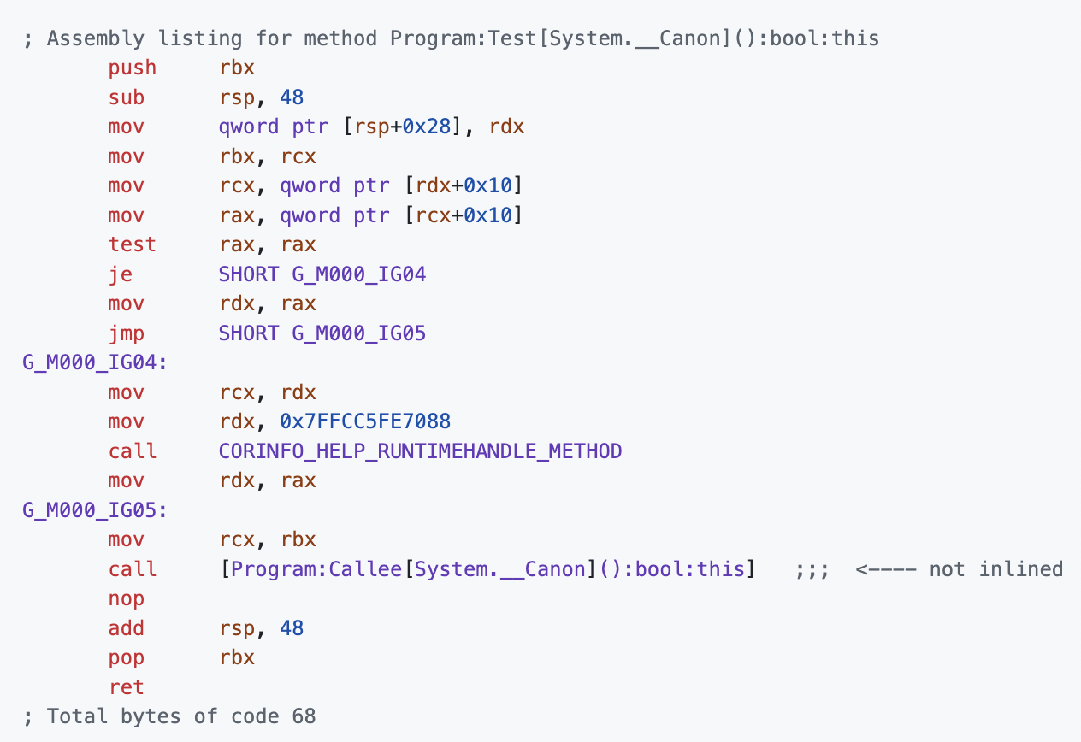
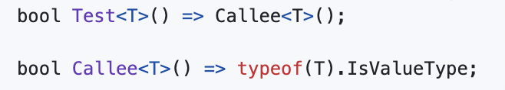
Inlining for shared generics
.NET 8.0 Codegen
Runtime lookup to
resolve which type is being used
Test<string>();

Slide 22
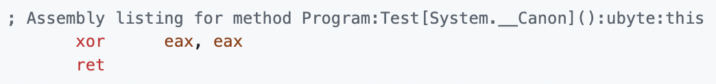
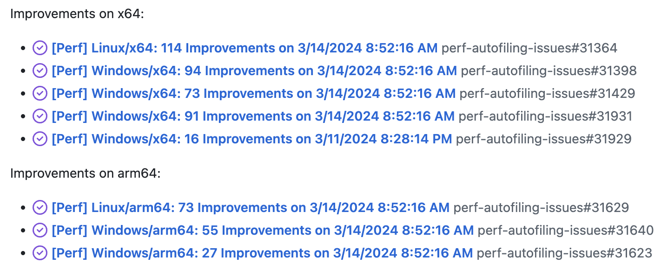
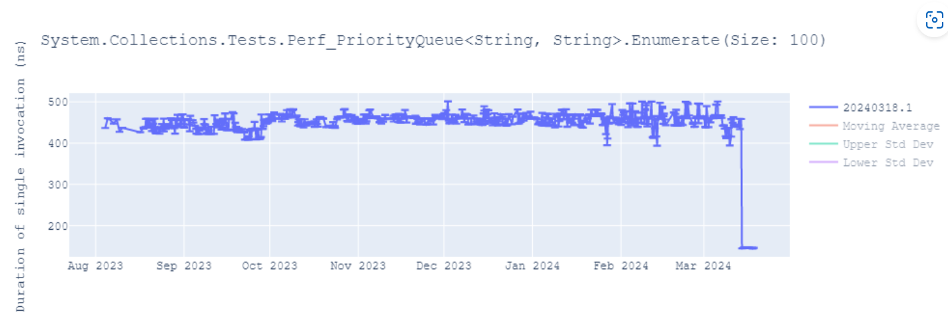
Inlining for shared generics
.NET 9.0 Codegen

Slide 23
Wrapping Up

Slide 24
You’ve now seen a small sample of the ~1100 changes to codegen in .NET 9
For the most part, all you need to do to benefit from this work is update to .NET 9!
We’d love to hear your feedback, good or bad. You can reach us on the dotnet/runtime github repo.
We’re especially interested in feedback if you port your apps to run on ARM64 / Cobalt 100, or try the new experimental SVE extensions

Slide 25
Resources
https://github.com/dotnet/runtime
fadda v17.d, p0, v17.d, z16.d
dotnet runtime github repo
https://sharplab.io/
Disasmo
Online .NET codegen viewer
Disasmo VS 2022 add-in
Engineering SVE Support in .NET
Stack Allocation Enhancements
.NET Blog post on ARM’s Scalable Vector Extensions
Tracking issues for improvements to stack allocation
.NET 10 Proposed JIT Work Items
mov eax, ecx
Preview of work we envision for .NET 10

Slide 26
Thank you

